Slide 1
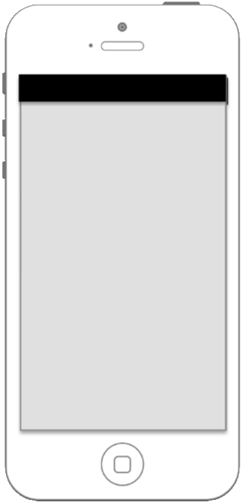


First screen always quiz. To change, go to menu ->
Quiz state
Basic needs
Supporting needs
Surroundings state
Extra information

Slide 2
Answer quiz
Quiz state
Map statistics
Basic needs
Disaster Survival tips
Supporting needs
Environrment state
Disaster specific information
Extra information

Slide 3
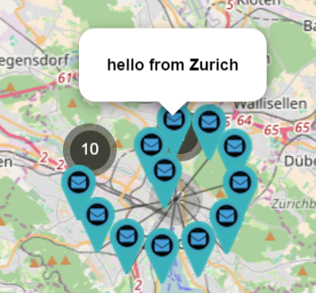





This map shows other people needs:
Water
Swarm Pulse maps ->
Water
Urgent rescue
Water
User selects which type wants to display from a list ->
Food
Medicines

Slide 4




Survival Tips
General preparation for any emergency
Tsunami
Terrorist attack
Tornado
Earthquake

Slide 5
Survive
General preparation for any emergency
Most important documents...
Shows useful information regarding this type of natural disaster ->
Well-stocked go-bag...

Slide 6
Survive
Earthquake
BEFORE…
Shows useful information regarding this type of natural disaster ->
DURING...
AFTER...

Slide 7
Survive
Tsunami
BEFORE…
Shows useful information regarding this type of natural disaster ->
DURING...
AFTER...

Slide 8
Survive
Basic needs
Add question
Add question
Add question
Send

Slide 9
Survive
Supporting needs
Add question
Add question
Add question
Send

Slide 10
Survive
Surrondings state
Add question
Add question
Add question
Level of buildings destruction:
Select
I (we) can survive alone for:
Select
Level of water:
Select
Send

Slide 11
Survive
Disaster Specific Information
Someone is injured
Someone is stuck
Someone needs urgent help
Level of buildings destruction:
Select
I (we) can survive alone for:
Select
Level of water:
3-5 meters
None
1-3 meters
3-5 meters
More than 5 meters

